Slide 1
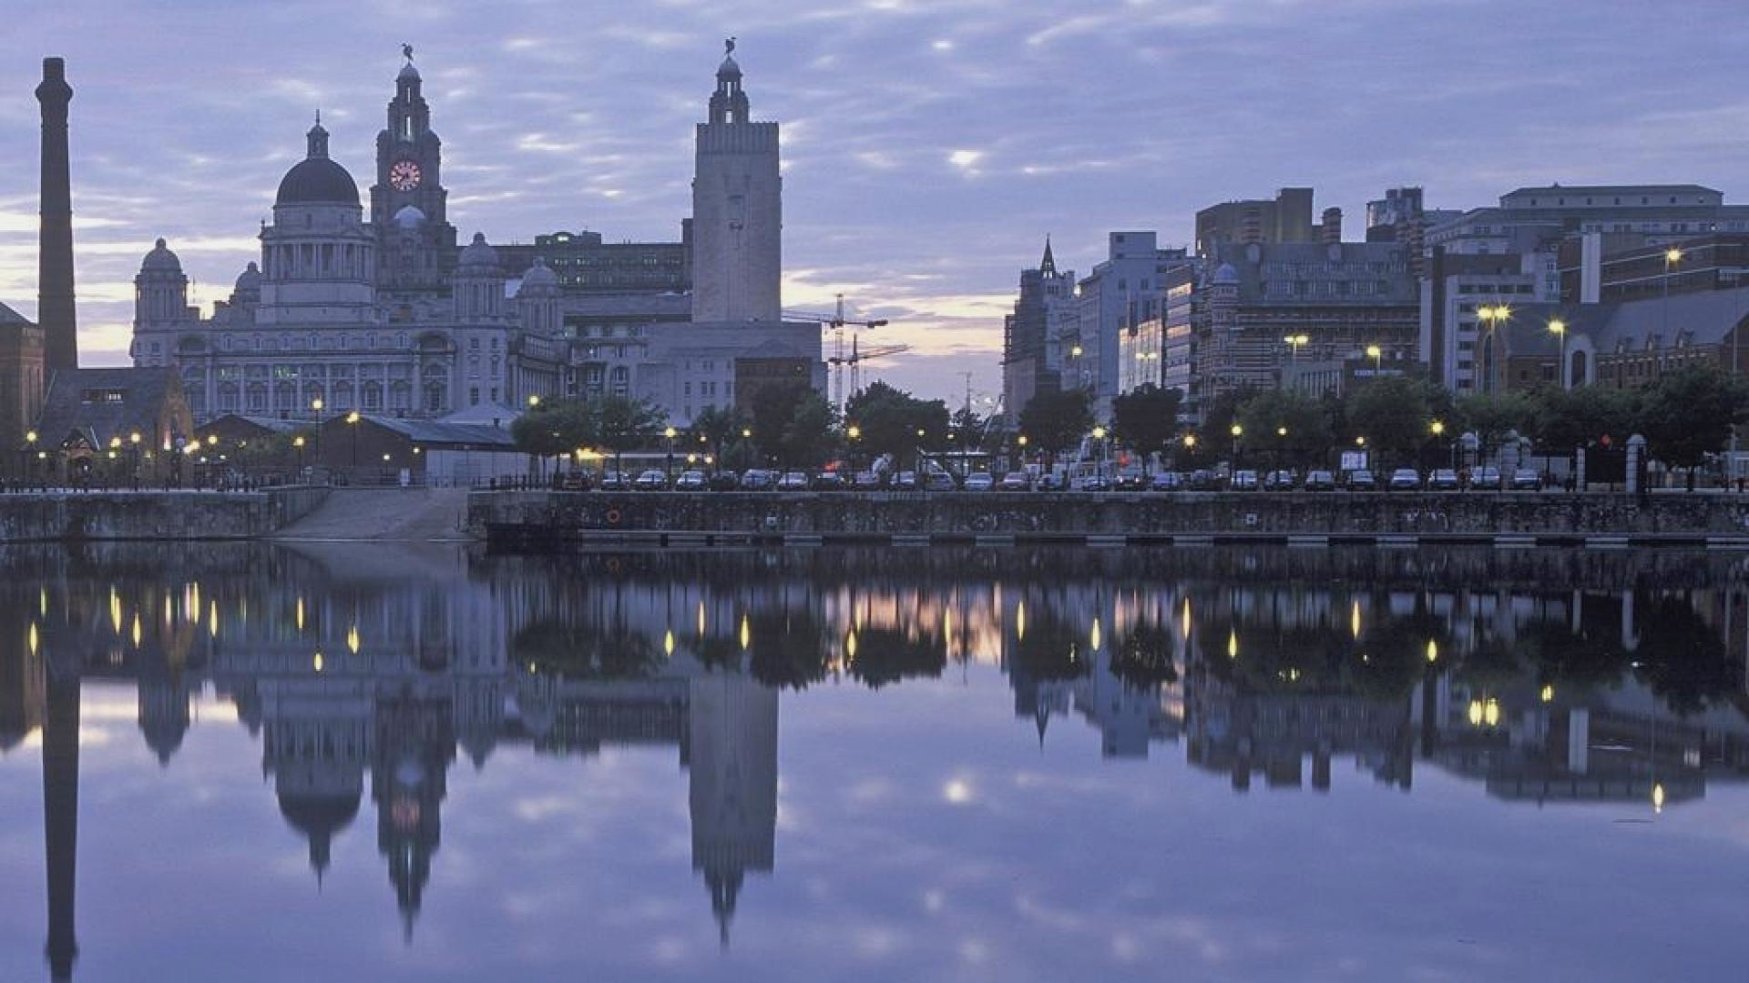
Liverpool
Mikhailovskaya Kristina, 3-1/4

Slide 2
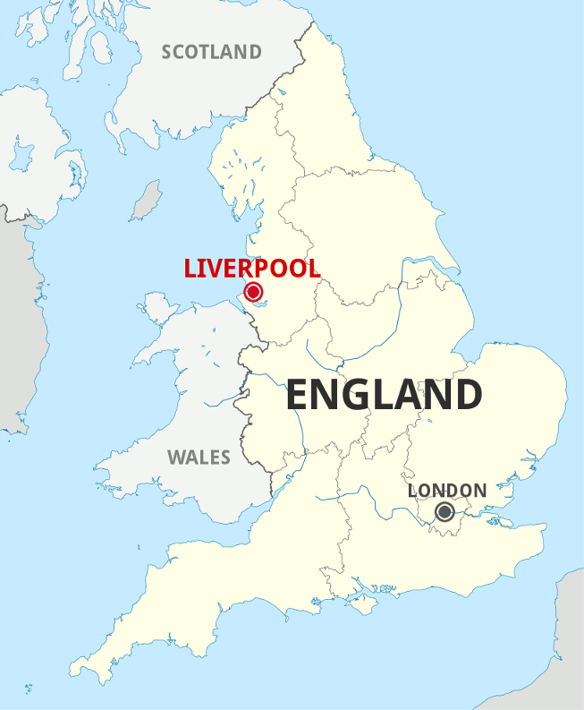
Liverpool is a city in the United Kingdom on the northwest coast of England, in the county of Merseyside.

Slide 3
Historical facts

Slide 4
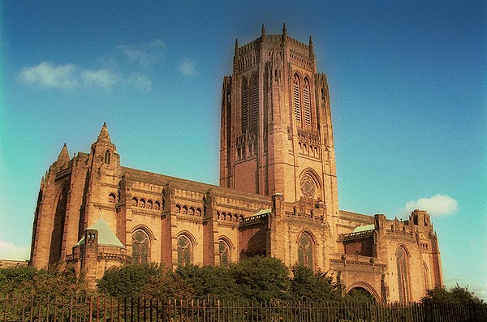
Liverpool Cathedral

Slide 5
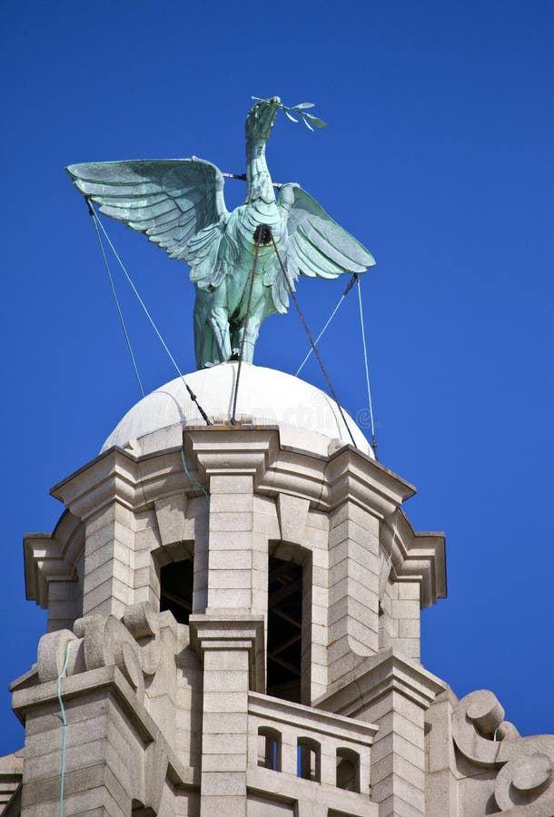
The symbol of the city

Slide 6
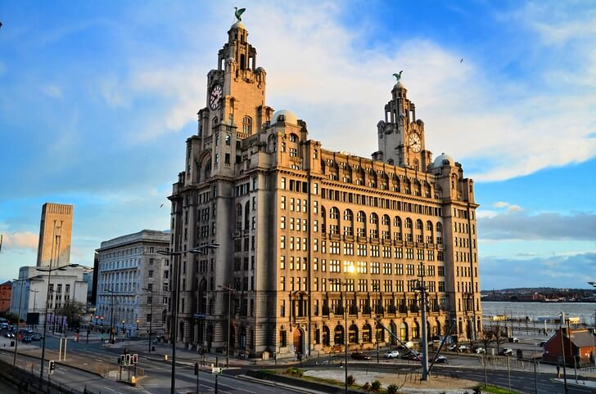
Royal Life Building

Slide 7
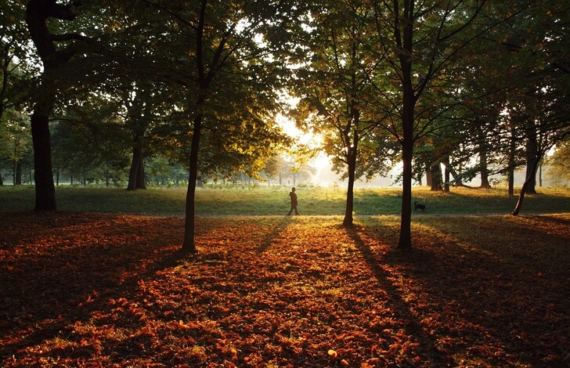
Sefton Park

Slide 8
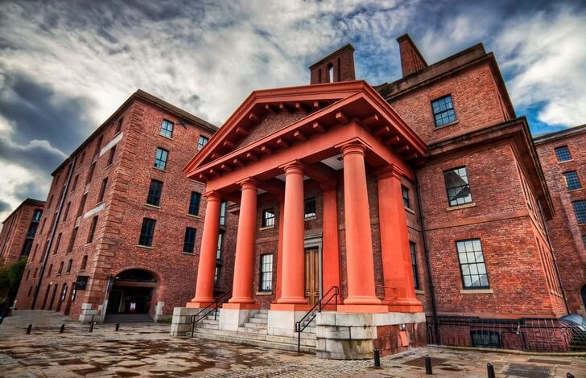
The International Museum of Slavery

Slide 9
Thanks for your attention.

